Slide 1
INFINITE AND STOCHASTIC GAMES
JEEVANA BHAGYASRI NAGOTHU
1847507
POONAM MEDASANA
1874750
MASTER’S IN AIRO
Subject : Reasoning Agents(Elective in AI)

Slide 2
INDEX
INFINITE GAMES
1.1Introduction
1.2 Foundations to Games
1.3 Reachability, Bϋchi, and Parity Games
STOCHASTIC GAMES
2.1 Simple Stochastic Games
2.2 Properties of Simple Stochastic Games

Slide 3
Infinite Games
1.1 Introduction to Infinite Games:
Why Infinite Games?
The emergence of reactive systems requires new approaches to verification and synthesis.
to model and analyze reactive systems in a game-theoretic framework, which captures the antagonistic and strategic nature of the interaction between the system and its environment.
What is Church’s Problem?
an environment generating an infinite stream of input bits, each of which is answered by an output bit generated by the circuit.
if the pair of bitstreams satisfies the requirement, then the circuit wins, otherwise the environment wins.

Slide 4
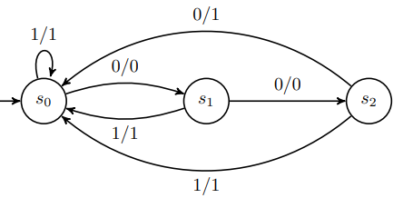

Requirements to satisfy Church’s Problem:
Whenever the input bit is 1, then the output bit is 1, too
At least one out of every three consecutive output bits is a 1.
If there are infinitely many 0’s in the input stream, then there are infinitely many 0’s in the output stream
Ex: The label 1/1 stands for “process a 1 and output a 1”.

Slide 5
1.2 The Foundations
Arenas, Games, and Strategies:
Arena: An arena A = (V, V0, V1, E) consists of
• a finite set V of vertices,
• disjoint subsets V0, V1 ⊆ V with V = V0 ∪ V1 denoting the vertices of Player 0 and Player 1
respectively, and
• a set E ⊆ V × V of (directed) edges such that every vertex has at least one outgoing edge, i.e.,{v0| (v, v0) ∈ E} is non-empty for every v ∈ V .The size of A, denoted by |A|, is defined to be |V |.
Sub-Arena:
Let A = (V, V0, V1, E) be an arena and V 0 ⊆ V be such that every vertex in V 0 has a successor vertex in V 0 .
The sub-arena of A induced by V 0 , denoted by AV 0 , is defined as AV 0 = (V ∩ V 0 , V0 ∩ V 0 , V1 ∩ V 0 , E ∩ (V 0 × V)).

Slide 6
Play:
A play in an arena A = (V, V0, V1, E) is an infinite sequence ρ= ρ0ρ1ρ2 · · · ∈ Vω such that (ρn, ρn+1) ∈ E holds for every n ∈ N. We say ρ starts in the vertex ρ0.
The set of plays in A is denoted by Plays(A), the set of all plays starting in v by Plays(A, v), and we define Plays(A, V 0) =S v∈V0 Plays(A, v) for every V0 ⊆ V .
Strategy:
A strategy for Player i ∈ {0, 1} in an arena (V, V0, V1, E) is a functionσ : V∗Vi → V such that σ(wv) = v0 implies (v, v0) ∈ E for every w ∈ V∗ and every v ∈ Vi.

Slide 7
Consistent Play:
A play ρ0ρ1ρ2 · · · in an arena A = (V, V0, V1, E) is consistent with a strategy σ for Player i in A if, ρn+1 = σ(ρ0 · · · ρn) for every n ∈ N with ρn ∈ Vi.
Given a vertex v, we denote the set of plays that are consistent with σ and start in v with Plays(A, v, σ). Finally, we define Plays(A, V 0 , σ) for V 0 ⊆ V by Plays(A, V 0 , σ) S v∈V 0 Plays(A, v, σ) .
Positional Strategy:
A strategy σ for Player i in an arena (V, V0, V1, E) is positional if σ(wv) = σ(v) for all w ∈ V∗ and v ∈ Vi.
Game:
A game G = (A,Win) consists of an arena A with vertex set V and a set of winning sequences Win ⊆ Vω.
We call a sequence ρ winning for Player 0 if, and only if, ρ ∈ Win and winning for Player 1 otherwise.

Slide 8
Winning Strategy:
Let G = (A,Win) be a game with A = (V, V0, V1, E). A strategy σ for Player i in A is a winning strategy from a vertex v ∈ V if every play that is consistent with σ and starts in v is winning for Player i, i.e., if Plays(A, v, σ) ⊆ Win for i = 0 and Plays(A, v, σ) ⊆ V ω \ Win for i = 1.
Winning Region:
The winning region Wi(G) of Player i in a game G is the set of
Vertices from which Player i has a winning strategy.
Determinacy, Positional Determinacy:
Let G be a game with vertex set V . We say
that G is determined if W0(G) ∪ W1(G) = V .
we say that G is positionally determined if, from every vertex v ∈ V one of the players has a positional winning strategy.

Slide 9
Uniform Positional Winning Strategy:
Let the game G = (A,Win). A strategy σ for Player i is a uniform positional winning strategy if it is positional and winning from every vertex in Wi(G).
Trap:
Let A = (V, V0, V1, E) be an arena and let T ⊆ V . Then, T is a trap for Player i, if every vertex v ∈ T ∩ Vi of Player i in T has only successors in T, i.e., (v, v0) ∈ E implies v0 ∈ T, and every vertex v ∈ T ∩ V1−i of Player 1 − i in T there is a successor in T, i.e., there is some v0 ∈ T with (v, v0) ∈ E.
Prefix-independence:
A winning condition Win ⊆ Vω is prefix-independent , if ρ ∈Win ⇔ w · ρ ∈ Win for all ρ ∈ Vω and all w ∈ V∗.

Slide 10
1.3 Reachability, Bϋchi, and Parity Games
Reachability Game:
Let A = (V, V0, V1, E) be an arena and let R ⊆ V be a subset of A’s vertices. Then, the reachability condition Reach(R) is defined as Reach(R) := {ρ ∈ V ω | Occ(ρ) ∩ R 6= ∅}. We call a game G = (A, Reach(R)) a reachability game with reachability set R.
Attractor:
Let A = (V, V0, V1, E) be an arena, let R ⊆ V , and let i ∈ {0, 1} determine a player.

Slide 11
Safety Games:
Let A = (V, V0, V1, E) be an arena and let S ⊆ V be a subset of A’s vertices.
Safety(S) := {ρ ∈ V ω | Occ(ρ) ⊆ S}. We call a game G = (A, Safety(S)) a safety game with set S of safe vertices.
Dual Arena:
Let A = (V, V0, V1, E) be an arena. The dual arena A of A is defined as A = (V, V1, V0, E).
“Safety and Reachability games are determined with uniform positional winning strategies and can be solved in linear time in the number of edges of the underlying arena.”

Slide 12
Bϋchi Game:
Let A = (V, V0, V1, E) be an arena and let F ⊆ V be a subset of A’s vertices.
Bϋchi condition Bϋchi (F) is defined as Bϋchi (F) := {ρ ∈ Vω| Inf(ρ) ∩ F 6= ∅}.
G = (A, Bϋchi (F)) a Bϋchi game with recurrence set F.
Recurrence: Let A = (V, V0, V1, E) be arena and let F ⊆ V .
• F0 = F,
• Wn1 = V \ Attr0(Fn) for every n ≥ 0, and
• Fn+1 = F \ CPre1(Wn1) for every n ≥ 0.

Slide 13
Co-Bϋchi Games:
Let A = (V, V0, V1, E) be an arena and let C ⊆ V be a subset of A’s vertices.
coBϋchi (C) := {ρ ∈ Vω| Inf(ρ) ⊆ C}.
G = (A, coBϋchi (C)) a co-Bϋchi game with persistence set C.
“Bϋchi and Co-Bϋchi games are determined with uniform positional winning strategies and can be solved in polynomial time in the number of edges of the underlying arena.”

Slide 14
Simple Stochastic Games(SSG)
A simple stochastic game (SSG) is a directed graph with three types of vertices, called max, min, and average vertices. There are a special start vertex and two special sink vertices, called the O-sink and the l-sink.
All vertices have exactly two neighbors, except for the sink vertices, which have no neighbors.
The graph models is a game between two players, 0 and 1.
A token is initially placed on the start vertex, and at each step of the game the token is moved from a vertex to one of its neighbors:
At a min vertex(Vmin), player 0 chooses the neighbor to which the token is moved.

Slide 15
At a max vertex(Vmax), player 1 chooses the neighbor to which the token is moved.
At an average vertex(Vaverage), a coin is tossed to determine where the token is moved, so that it is moved to each neighbor of the average vertex with probability ½.
The game ends when the token reaches a sink vertex; player 1 wins if it reaches the l-sink vertex and player 0 wins otherwise, that is, if the token reaches the O-sink vertex or if the game never halts.
max vertices, player 1 chooses its move to maximize the probability.

Slide 16
min vertices, player 0 chooses its move so as to minimize the probability of reaching the l-sink vertex.
Strategy for player 0 or 1 is a rule that defines what move the player takes whenever the token is at a min or max vertex.
What are the Best strategies of the players?
- P lie in the class NP n co-NP
Probability that player 1 wins the game, if both players use their best strategies?
- By deciding if the probability that player 1 wins is greater than ½ is not known to be in P.

Slide 17
Properties of SSG
A strategy τ of player 0 is a set of edges of E, each with its left end at a min vertex, such that for each min vertex i there is exactly one edge (i, j) in τ.
a strategy σ of player 1 is a set of edges of E, each with its left end at a max vertex such that for each max vertex i there is exactly one edge (i, j) in σ.
Pure stationary strategies :
The players do not use probabilistic choice in choosing a move.
Each player chooses the same move from a vertex every time that vertex is reached.

Slide 18
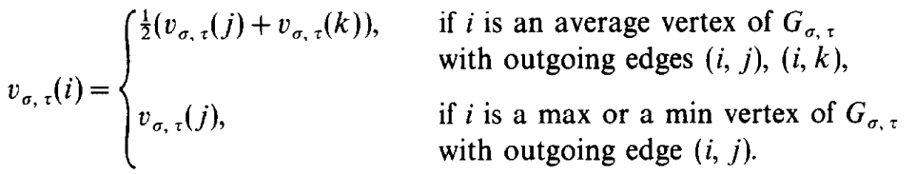
SSG halts with probability 1 if for all pairs of strategies τ, σ, every vertex in Gτσ has a path to a sink vertex.
Value: Vτσ(i) of each vertex i of G with respect to strategies σ and τ to be the probability that player 1 wins the game if the start vertex is i and the players use strategies σ and τ.
The values Vτσ(i), 1 ≤ i ≤ n satisfy the following conditions: If t < i ≤ n - 1 then Vτσ(i) = 0 and Vτσ(n) = 1; otherwise
-- equation (1)

Slide 19
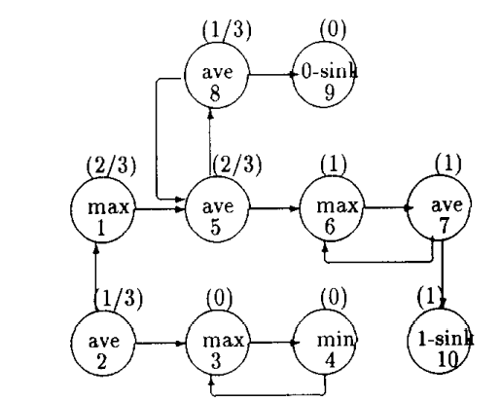
For Example;
A simple stochastic game with 10 vertices. Vertex 1 is the start vertex.
Corresponding to strategy σ is a graph Gσ, which is the subgraph of G obtained by removing from each max vertex the outgoing edge that is not in the strategy σ.

Slide 20
Pair of strategies τ and σ, is a graph G τ,σ obtained from Gσ by removing from each min vertex the outgoing edge that is not in τ.
In G τ,σ, every max and min vertex has one outgoing edge.
G τ,σ can be considered as a Markov process where the states of the process are the vertices of G and the transition probabilities p ij, 1 ≤ j and j ≤ n as defined:
If i ≤ n - 1 then p i,j = ½ if i is an average vertex with outgoing edge (i, j); p i,j = 1 if i is a max or min vertex with outgoing edge (i, j), and p i,j = 0 otherwise.
Since n - 1 and n are sink states, we define p nn =p n-1n-1=l, p nj=O if j ≠ n and p nj = 0 if j ≠ n.
Strategies σ = { (1, 5), (3,4), (6, 7) } and τ = { (4, 3) } of player 1 and 0, respectively.

